Slide 1

Financial Literacy Association’s Stock Market Competition
2018-2019 Orientation

Slide 2
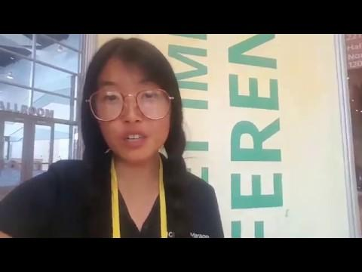
Julie Lim!

Slide 3
Overview
FLA & SMC Intro
Chris Schwarz
Stock Trak
Competition Requirements
Past Winners
Amazon Gift Card Raffle

Slide 4
Financial Literacy Association (FLA)
Mission:
Provide UCI students with the resources to manage
their personal finances and improve their financial literacy

Slide 5
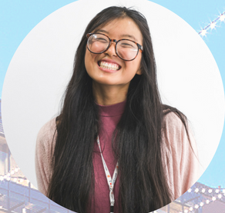


Stock Market Competition Intro
Purpose
Increase financial literacy
Prepare you to manage future wealth
How?
Provide knowledge on investments & stock market
Hands-on experience (Stock Trak)
Background:

Slide 6
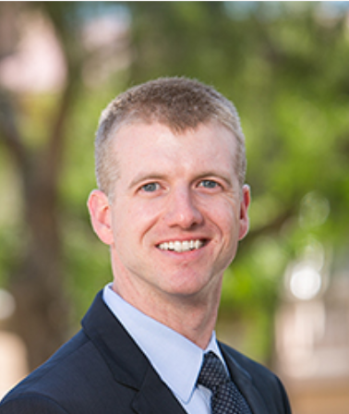
Chris Schwarz
Faculty Director, Center for Investment and Wealth Management
Associate Professor, Finance
Lecturer for most SMC Workshops

Slide 7
Why Invest?
Make your money make money
Beat inflation

Slide 8
Stock Trak
Online platform we use
Mandatory to register (free)
Trade notes (justification)
Any issues/questions about Stock Trak: e-mail help-desk@stocktrak.com
Did anyone who already registered have to pay?

Slide 9
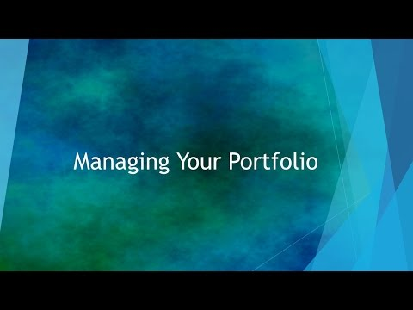
Tutorial

Slide 10

More Tutorial Resources
https://content.stocktrak.com/wp-content/uploads/2017/01/ST-student-user-guide.pdf

Slide 11
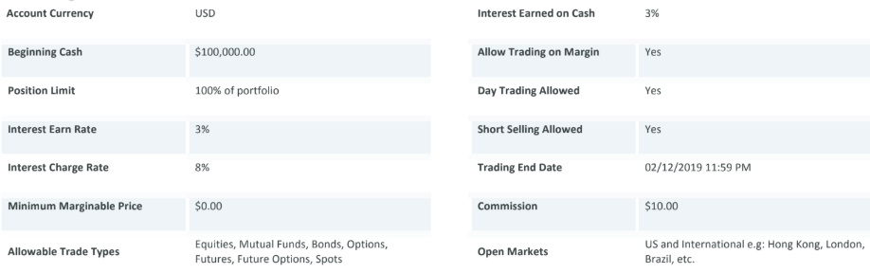
Stock Trak Trading Parameters

Slide 12
Competition Requirements

Slide 13
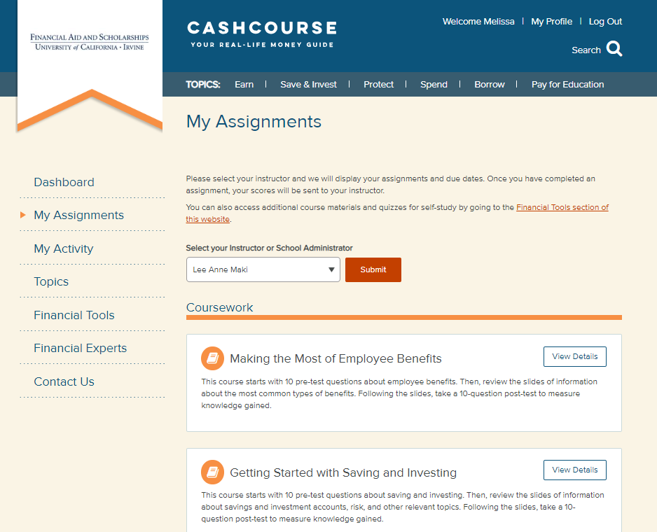
#1: Complete CashCourse
Complete all 5 lessons by end of competition

Slide 14
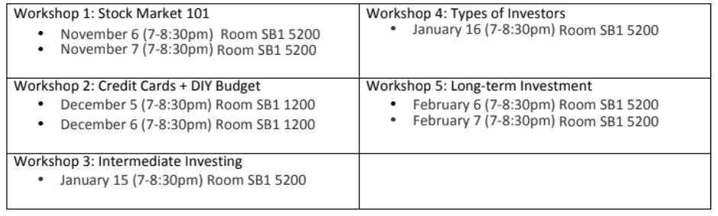
#2: Workshops
Minimum of 1 workshop attended

Slide 15
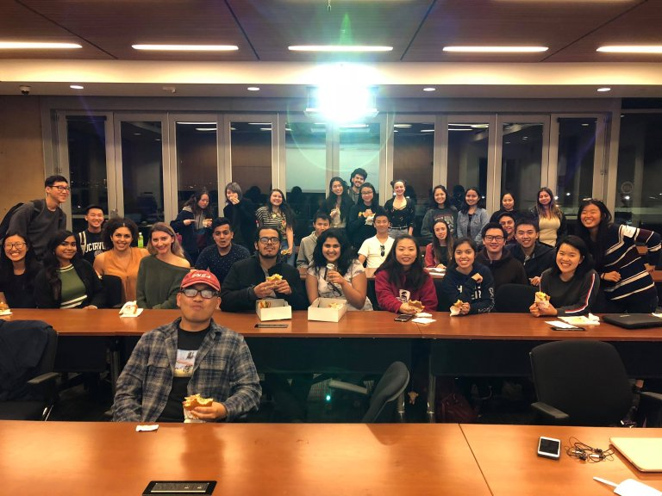
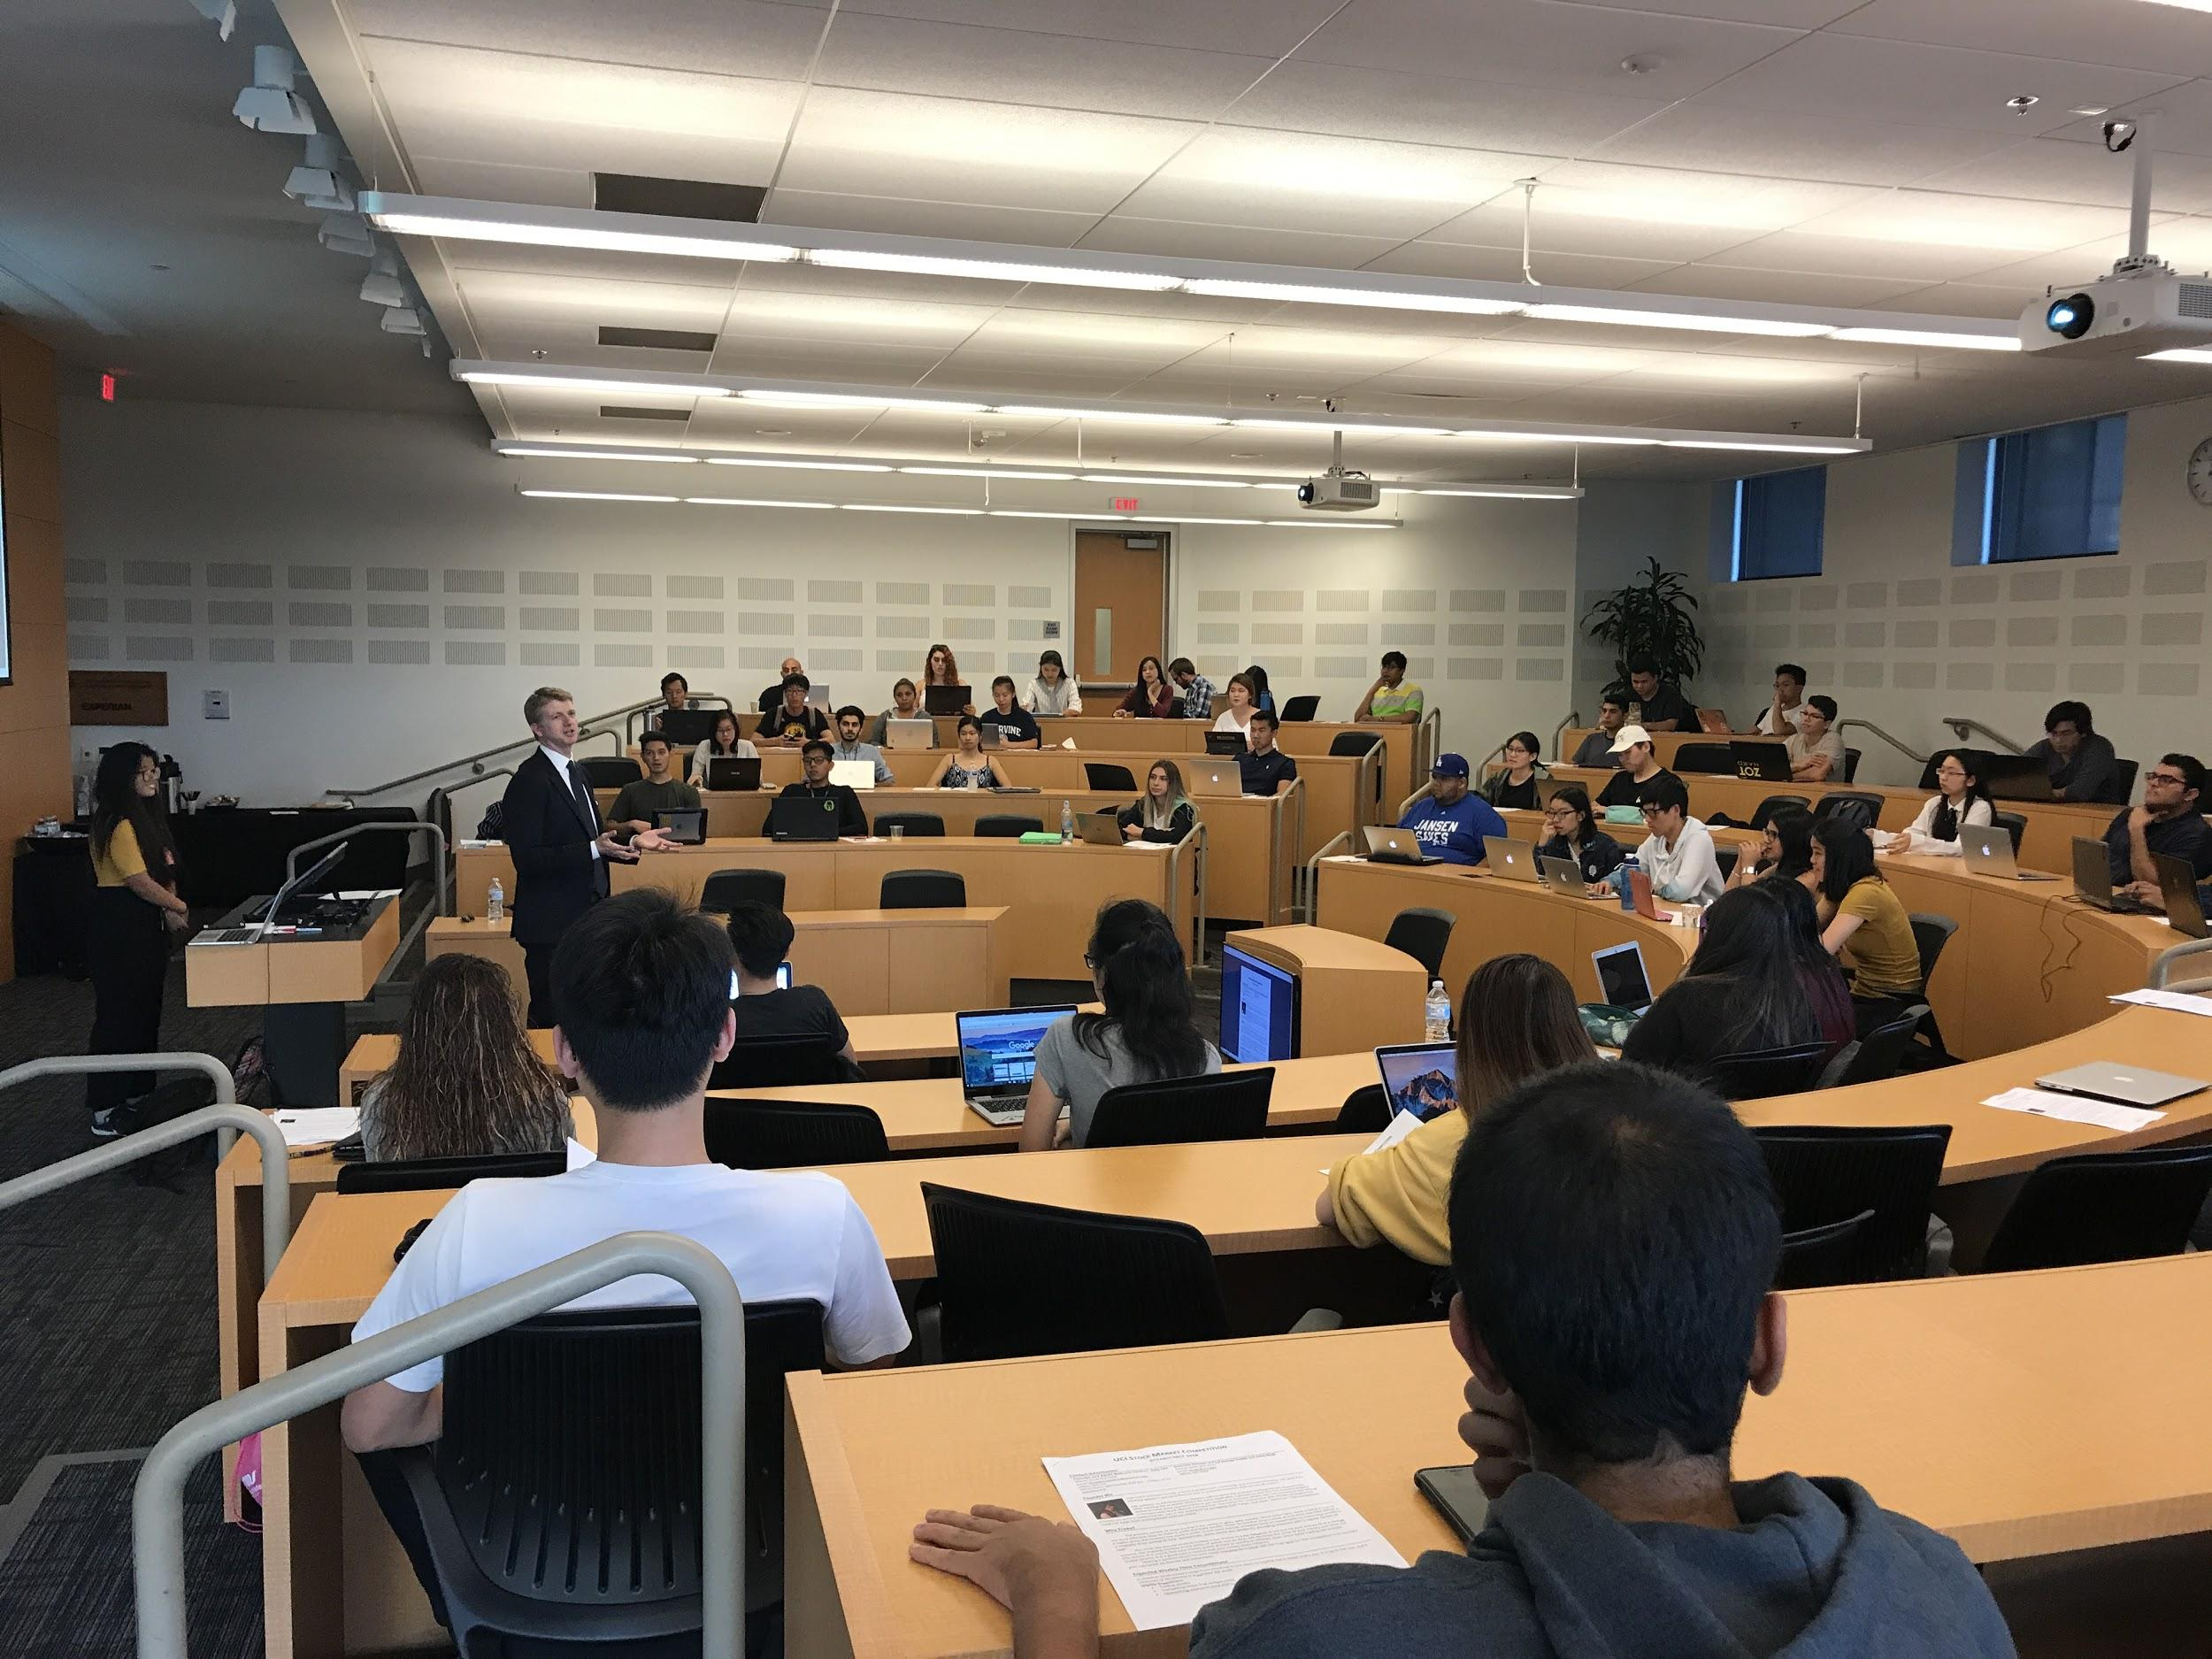
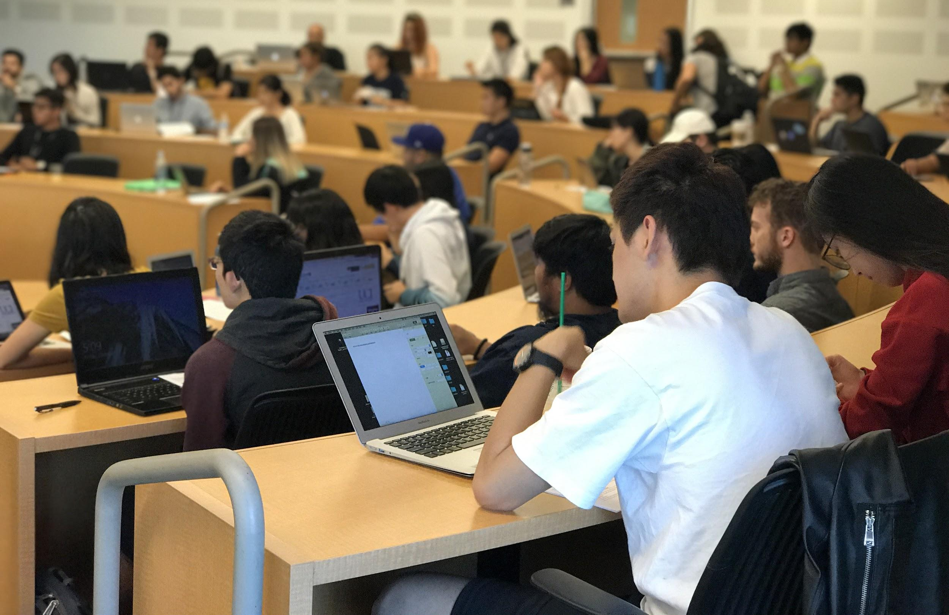
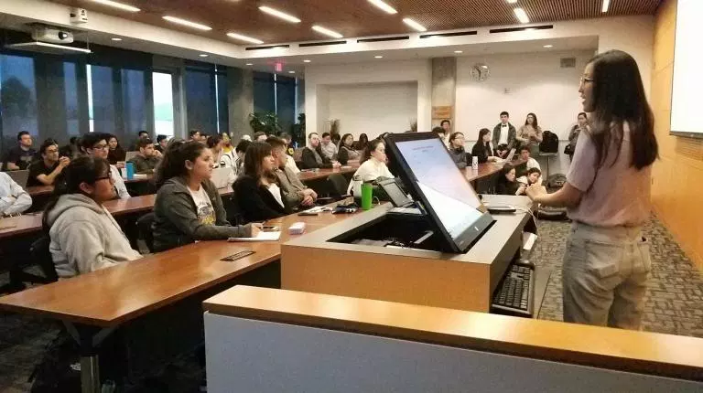

Slide 16


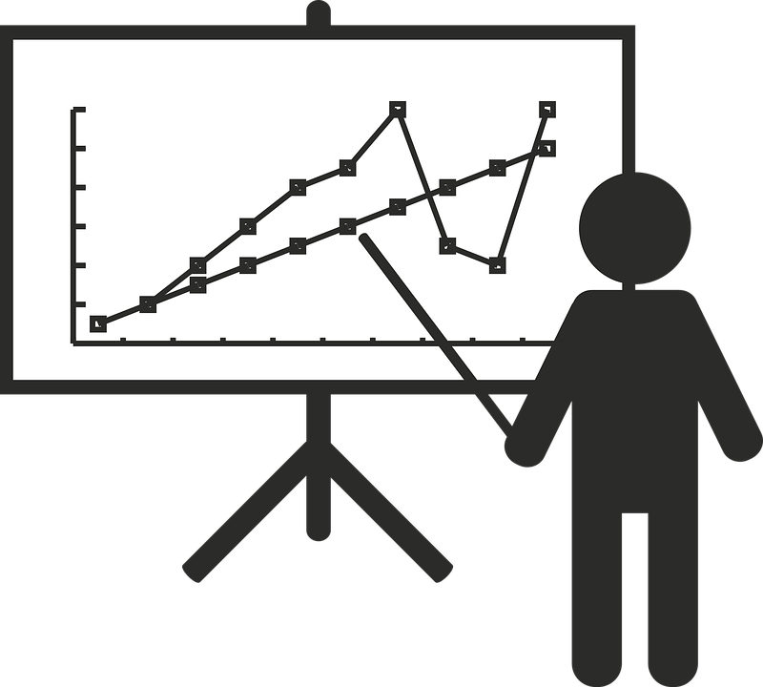
#4: Presentation
Due March 8, 2019
Top 10 strategy papers
10-15 slide PPT
#3: Strategy Paper
Due Feb. 22, 2019
1-4 pages
Investment Strategy
Learning Outcomes

Slide 17
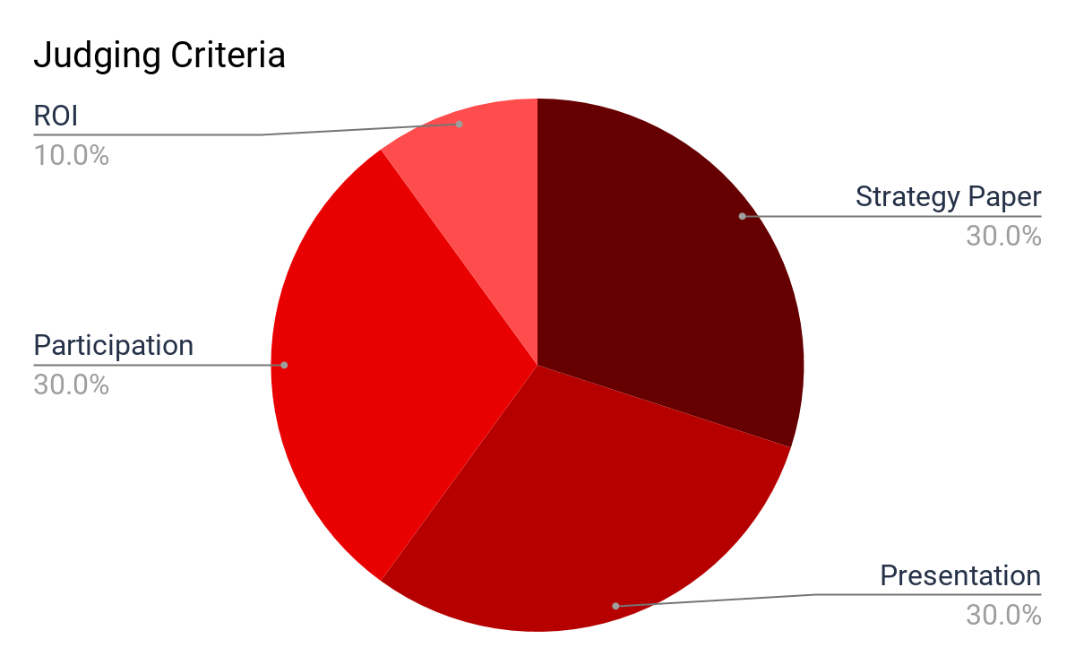
(Return on Investment)

Slide 18
What Changed From Last Year?
CashCourse requirement
Judging criteria: learning growth > ROI
Monthly workshops (no longer quarterly)
Participation more heavily weighed (attend workshops!)
Past winners welcome to participate but can’t win
Graduate students welcome to participate but can’t win

Slide 19
Resources
Stock Market Competition Workshops
  November 6th & 7th 7:00-8:30pm SB1 5200
Office Hours
  Meet in person w/professionals in Finance Industry
  Offered by request -- e-mail FLA.ucirvine@gmail.com
Stock Trak resources
Financial Literacy Association Meetings
Syllabus!

Slide 20
Financial Literacy Association Meetings
Bi-weekly, Tuesdays @ 7:30-8:30pm
First meeting: November 13th @ SB1 5200 7:30-8:30pm
$5 membership fee OR volunteer on-call list
Topics:
Personal Finance
Renting v. Owning a Home
Impact Investing
How Taxes Work
Student Loans
Asset Management
Finance Industry
Robinhood v. Charles Schwab
Post-Grad
Gender Investing Gap

Slide 21
Back to the competition!

Slide 22
Stock Market Competition Prize Winners
1st place: $1,000
2nd place: $750
3rd place: $500

Slide 23
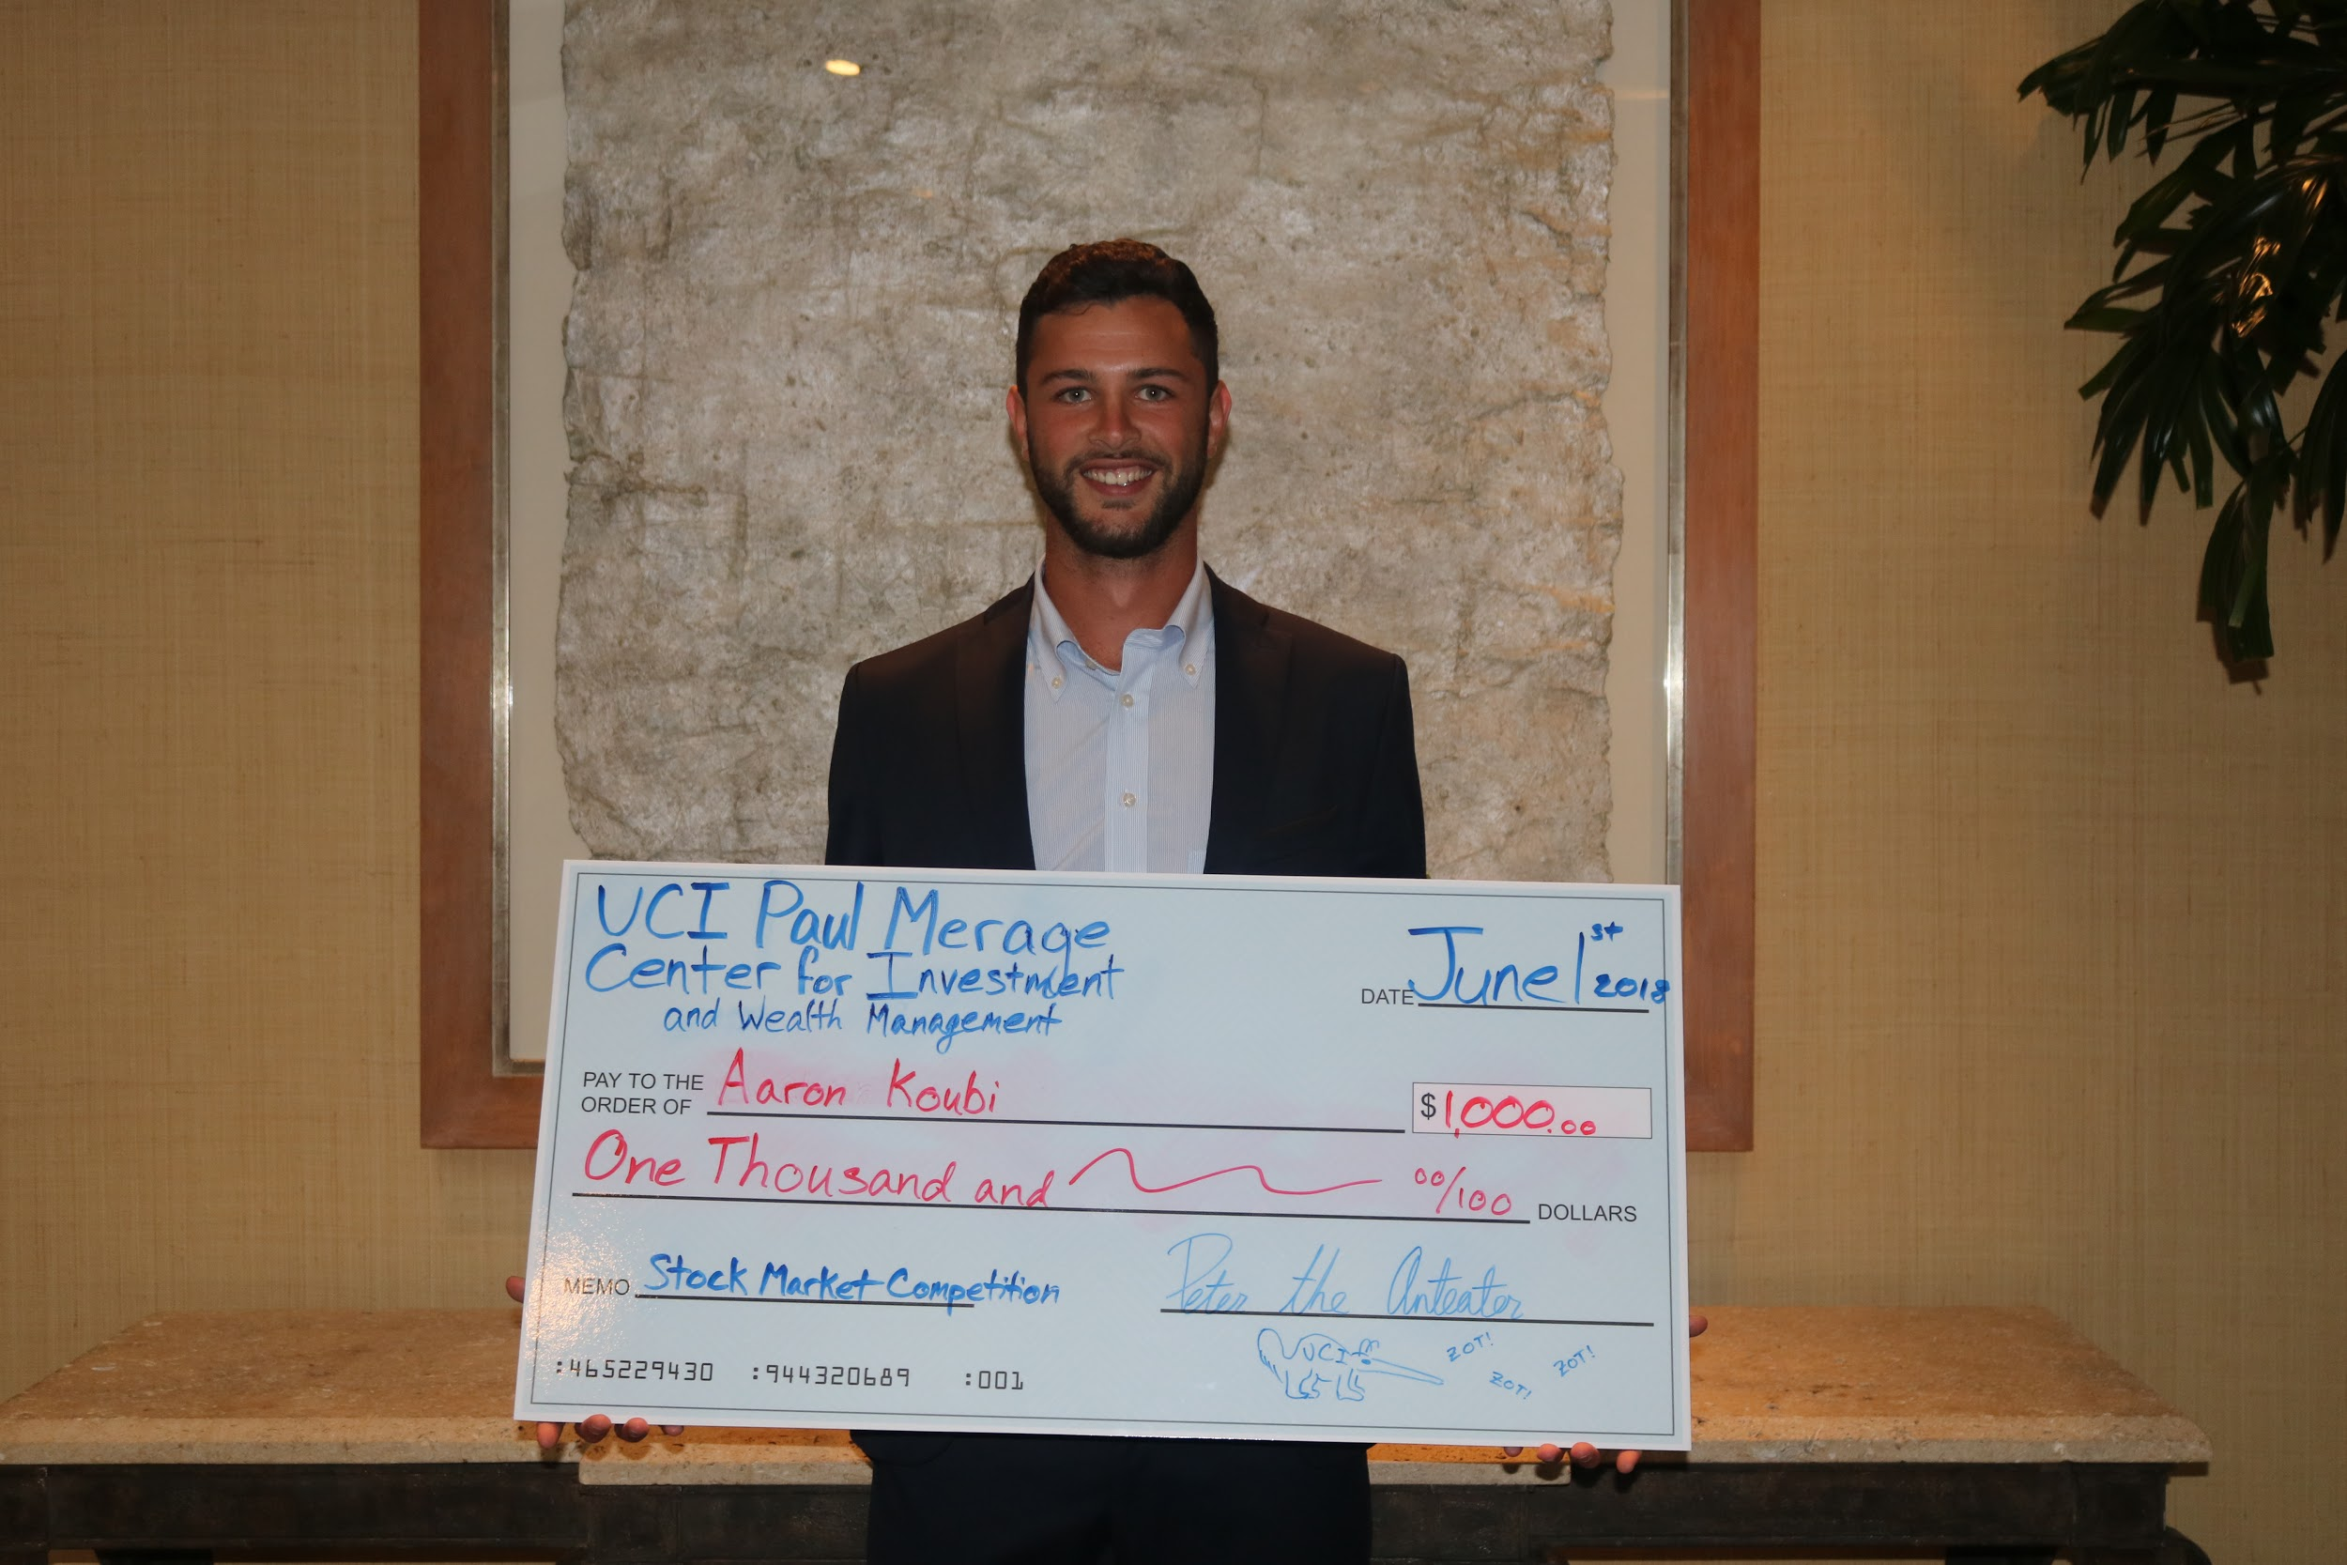
Aaron Koubi

Slide 24
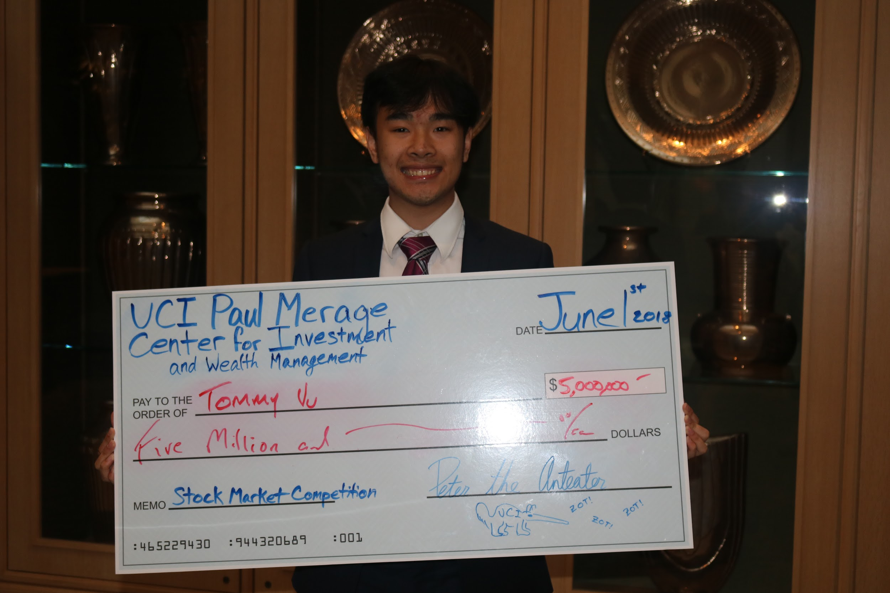
Calvin Nguyen

Slide 25
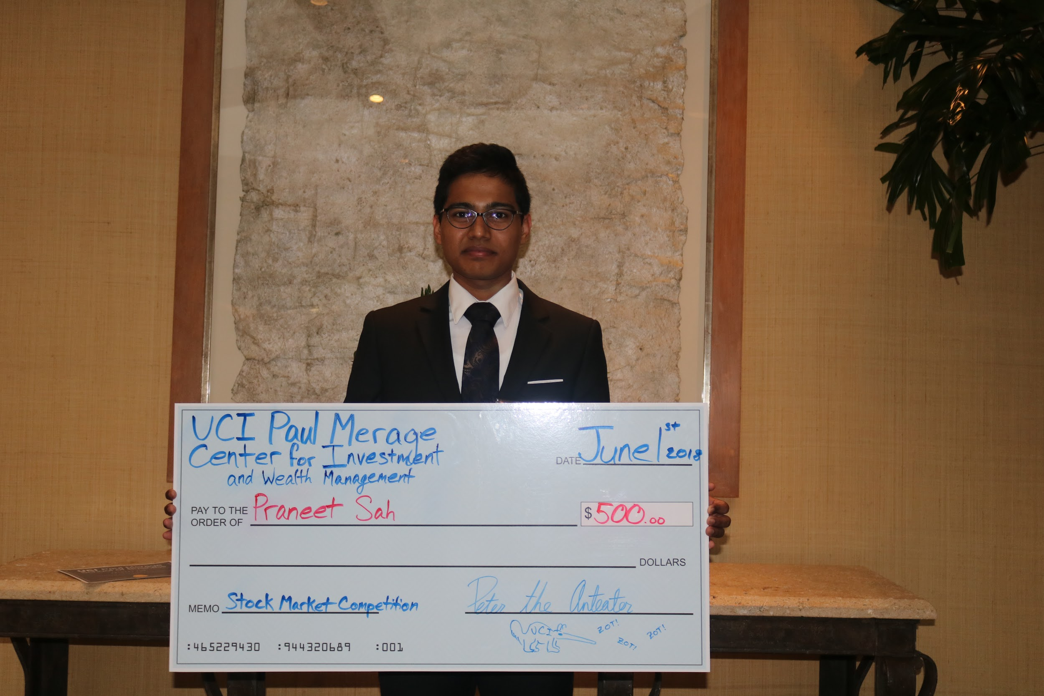
Praneet Sah

Slide 26
Contact Us
E-mail: fla.ucirvine@gmail.com
Website: www.flauci.weebly.com
Facebook: Financial Literacy Association FLA at UCI
Instagram: @fla.uci
Linkedin: @UCI Financial Literacy Association
Stock Trak help: help-desk@stocktrak.com

Slide 27
Amazon Gift Card Winners!

